Slide 1

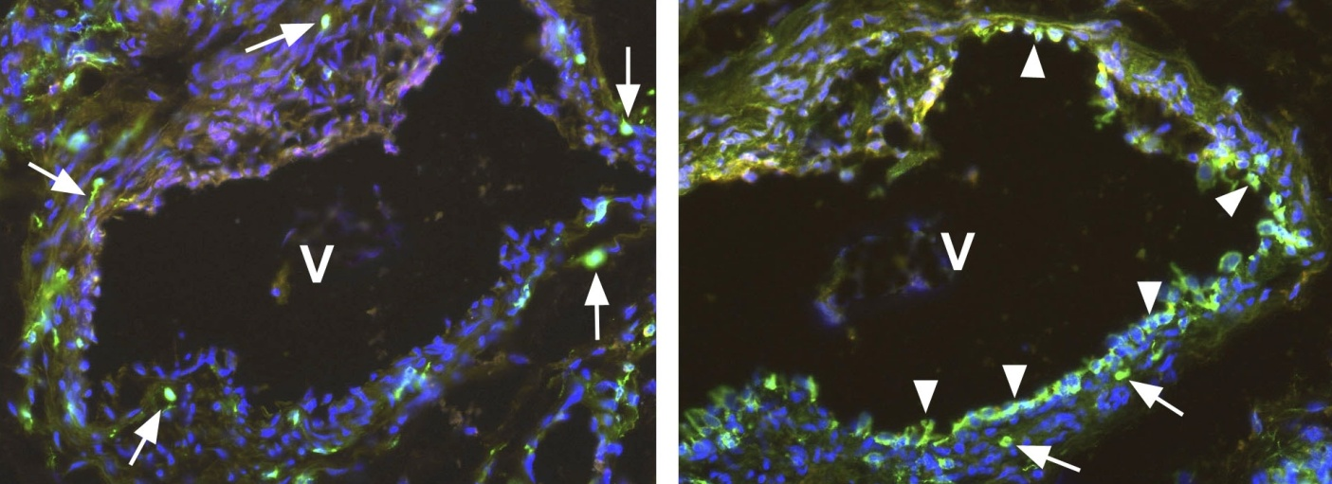
ReliaTech GmbH
Polyclonal antibody against native human soluble VEGFR-1/Flt-1
(Endogenous sFlt-1; Cat# 102-PA21S / -PA21)
Immunofluorescence staining (green) using our polyclonal antibody directed against the C-terminal end of native soluble VEGFR-1/Flt-1 (Cat# 102-PA21) (left panel) and our monoclonal antibody directed against the extracellular domain of the membrane-bound VEGFR-1/Flt-1 (Cat# 101-M30) (right panel). You see two neighboring sections of a human vein (V), located near a hemangioma. The antibody against the soluble VEGFR-1/Flt-1 marked single cells (arrows) within the media and adventitia of the vein. The antibody against the membrane-bound VEGFR-1/Flt-1 marked single cells (arrows) and the endothelium (arrowhead) of the vein. Cell nuclei are stained with Dapi (blue).
The experiment was performed by K. Butler and J. Wilting, University Göttingen, Germany.
http://www.reliatech.de / orders@reliatech.de

